Slide 1

Procedure for Taking Minutes in a Management-Level Committee Meeting using Copilot AI
Step-by-step guidance for accurate and consistent documentation
Notes:
This presentation guides you through the comprehensive procedure for effectively taking minutes during management-level committee meetings. We will cover preparation, actions during the meeting, post-meeting steps, finalization, follow-ups, and tips for consistency.

Slide 2
Minute-Taking Agenda
Preparation Before the Meeting
Actions During the Meeting
Steps Immediately After the Meeting
Finalization and Distribution of Minutes
Follow-Up Actions and Preparation for Next Meeting
Tips for Consistency in Minute-Taking
Notes:
We will explore key phases: preparing before the meeting, capturing and documenting during the meeting, steps immediately after, finalizing and distributing minutes, follow-up actions for accountability, and tips to maintain consistency in minute-taking practices.

Slide 3

Preparation Before the Meeting
Notes:
Reviewing the agenda and identifying key discussion items, Setting up Teams meeting with Copilot and permissions, Preparing templates and structuring minutes sections, Example Copilot prompt for summarizing discussions

Slide 4
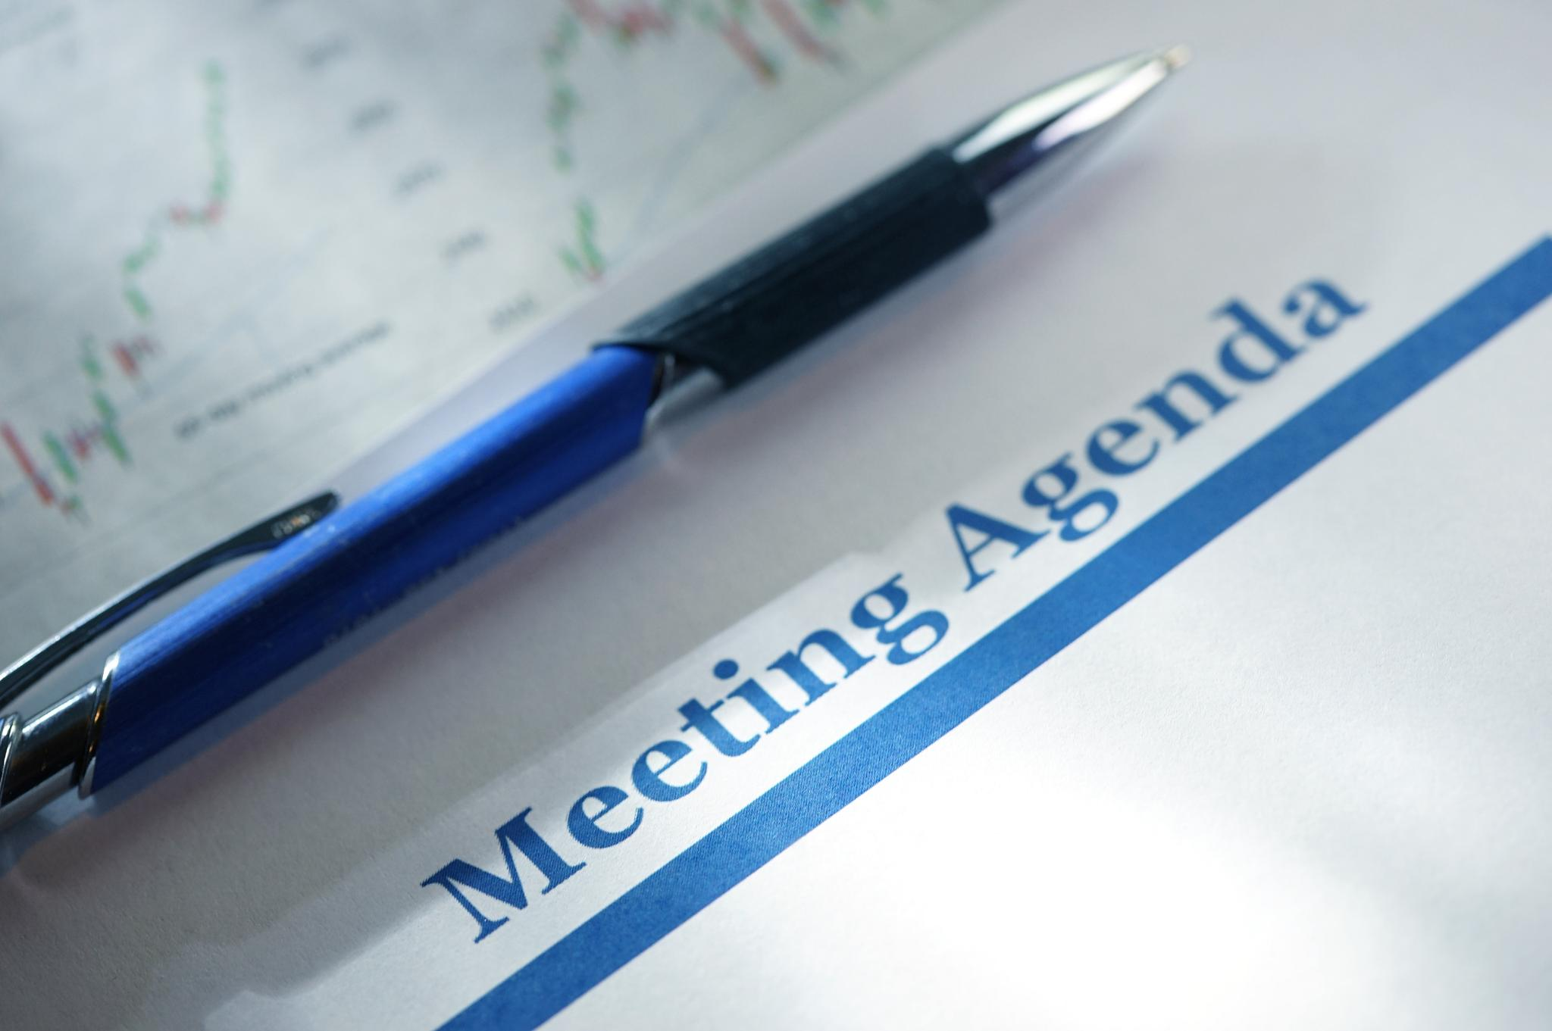
Reviewing the agenda and identifying key discussion items
Agenda Review
  Carefully examine the agenda to understand the topics scheduled for discussion.
Identify Key Items
  Highlight items likely to require thorough discussion, decision-making, or follow-up actions.
Notes:
Review the agenda
Identify key items that will likely require discussion, decisions, or follow‑up.

Slide 5
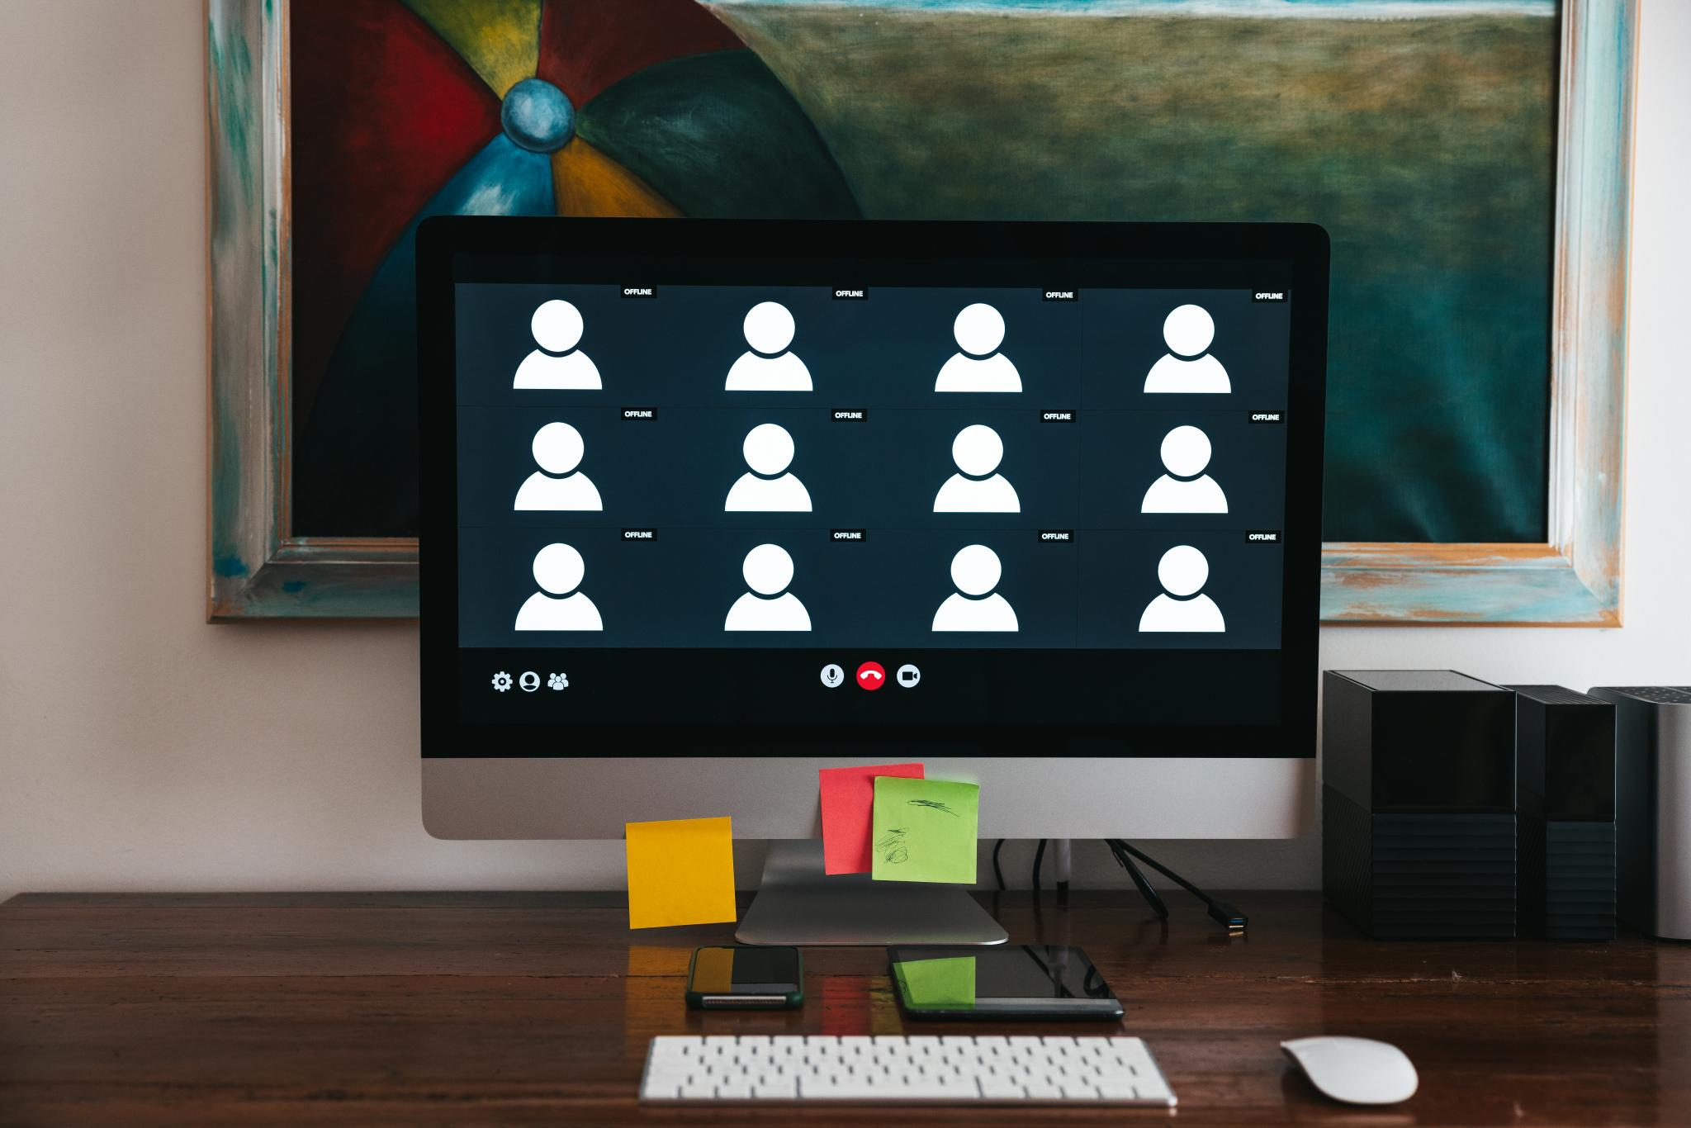
Setting up Teams meeting with Copilot and permissions
Enable Copilot in Teams Meeting
  Ensure Copilot feature is available before starting your Teams meeting to assist with note-taking and tasks.
Permissions
  Ensure you have appropriate permissions to use Copilot note-taking functionalities during meetings.
Notes:
Set up your Teams meeting with Copilot enabled
Ensure you have permission to use Copilot note-taking features.

Slide 6
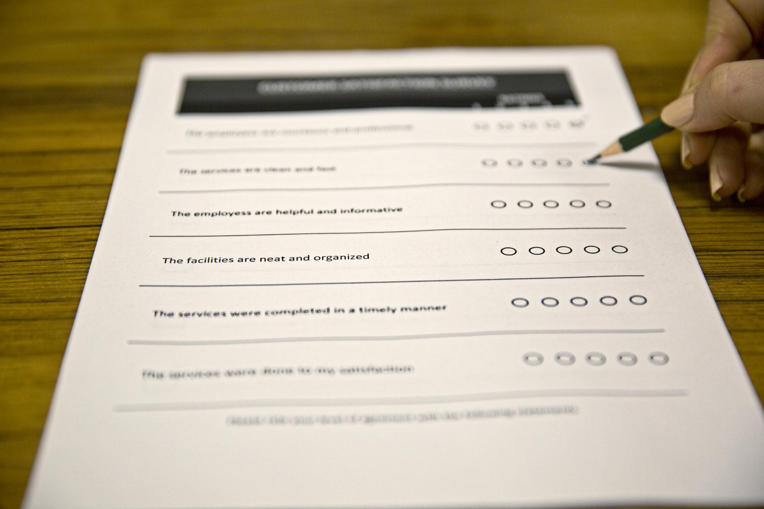
Preparing templates and structuring minutes sections
Template Preparation
  Ensure your meeting minutes template is prepared in advance to streamline note-taking.
Essential Sections
  Include key sections such as Attendees, Agenda Items, Key Discussion Points, Decisions, and Action Items.
Notes:
Have your template ready
Include sections for: Attendees, Agenda Items, Key Discussion Points, Decisions, and Action Items.

Slide 7

Example Copilot prompt for summarizing discussions
Summarizing Discussions
Including Questions and Comments
Using Proper Names
  PROMPT: Summarize the discussion from Mr. Smith on [insert topic] in an executive meeting minutes style paragraph. Include questions or additional comments, decisions made, and any follow up items. Use proper names for Example, Mr. Smith.
Notes:
Copilot prompt example:
“Summarize the discussion from Mr. Smith on Chair Comments in an executive meeting minutes style paragraph. Include questions or additional comments. Using proper name for Example, Mr. Smith.”

Slide 8

Actions During the Meeting
Notes:
Starting recording, transcription, and capturing attendance, Using Copilot to capture key discussion points, Focusing on key points, decisions, and next steps, Example Copilot prompts for meeting documentation

Slide 9

Starting recording, transcription, and capturing attendance
Enable Recording with Transcription
  Start recording the meeting with transcription enabled to ensure accurate detail reference and enhance accessibility.
Capture Attendance
  Mark attendance of committee members and guests to maintain accurate meeting participation records.
Teams Meeting Settings
  Enable attendance capture and transcription settings via Teams Meeting Options prior to starting the meeting.
Notes:
---
Start the recording with transcription enabled
This ensures accurate reference for details and supports accessibility.
Capture attendance
Mark which committee members and guests are present. Note: this may be a setting that you can enable in the Teams Meeting Options.
Image source: Microsoft 365 content library

Slide 10

Using Copilot to capture key discussion points
Utilizing Copilot During Meetings
  Leverage Copilot to assist in capturing important discussion points as agenda items conclude.
Prompt-Based Note Taking
  Use specific prompts aligned with agenda topics to ensure accurate and relevant key points are recorded.
Notes:
---what I do is have the agenda topics copied onto a OneNote notebook and prepare the prompts based on the agenda topics. Durring the meeting after each topic has been discussed, I enter the prompt into copilot and copy the response onto the notebook and continue this for eah topic
Review the agenda
Identify key items that will likely require discussion, decisions, or follow‑up.
Image source: Microsoft 365 content library
---
Use Copilot
As sections of the agenda are completed, use the prompt for that topic to capture the key discussion points from the meeting.
Image source: Microsoft 365 content library

Slide 11
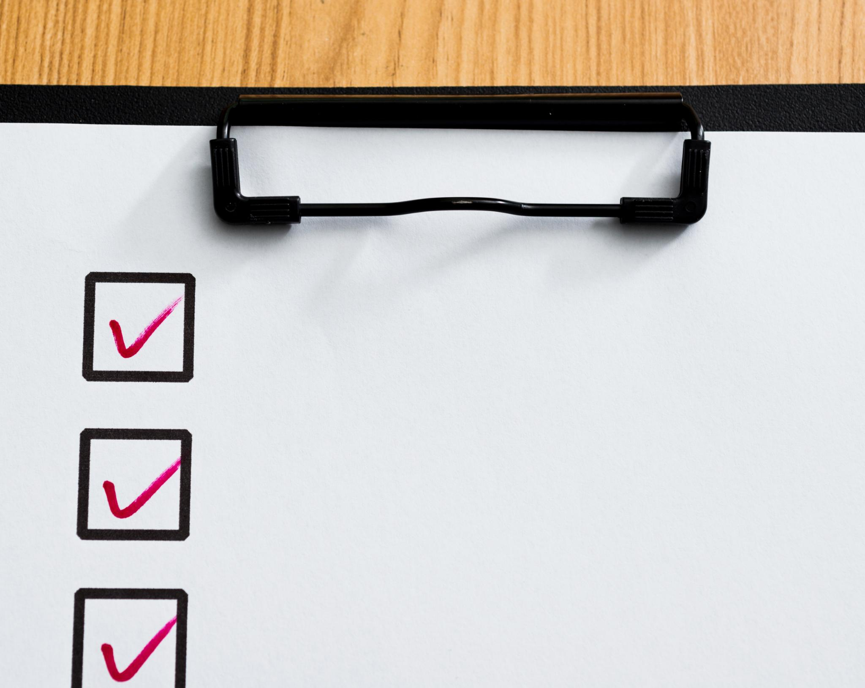
Focusing on key points, decisions, and next steps
Note Key Points
  Listen to capture essential ideas instead of detailed transcripts to maintain clarity and brevity.
Focus on Decisions
  Emphasize decisions made and their rationales to guide effective actions.
Next Steps
  Capture clear next steps to ensure progress and accountability in projects.
Notes:
---
Note key points, not transcripts
Focus on decisions, rationales, and next steps rather than full conversation details.
Image source: Microsoft 365 content library

Slide 12
Steps Immediately After the Meeting
Notes:
Generating and reviewing the first draft of minutes with Copilot, Editing for clarity, tone, and highlighting key takeaways

Slide 13

Generating and reviewing the first draft of minutes with Copilot
Drafting Minutes with AI
  Use Copilot to efficiently generate a first draft of meeting minutes, saving time and effort.
Reviewing for Accuracy
  Carefully review Copilot’s summary to ensure it is accurate and comprehensive before finalizing.
Notes:
---
Generate a first draft of minutes with Copilot
Review Copilot’s summary for accuracy and completeness.
Image source: Microsoft 365 content library

Slide 14
Editing for clarity, tone, and highlighting key takeaways
Clarity and Tone
Edit content to ensure clarity and maintain a neutral, professional tone throughout the notes.
Concise Notes
Keep notes concise by removing unnecessary information while preserving essential details.
Highlighting Key Takeaways
Emphasize decisions and action items to ensure they are prominently visible for easy reference.
Notes:
---
Edit for clarity and tone
Ensure the notes are concise, neutral, and professional.
Highlight key takeaways
Make sure decisions and action items are clearly visible.
Image source: Microsoft 365 content library

Slide 15
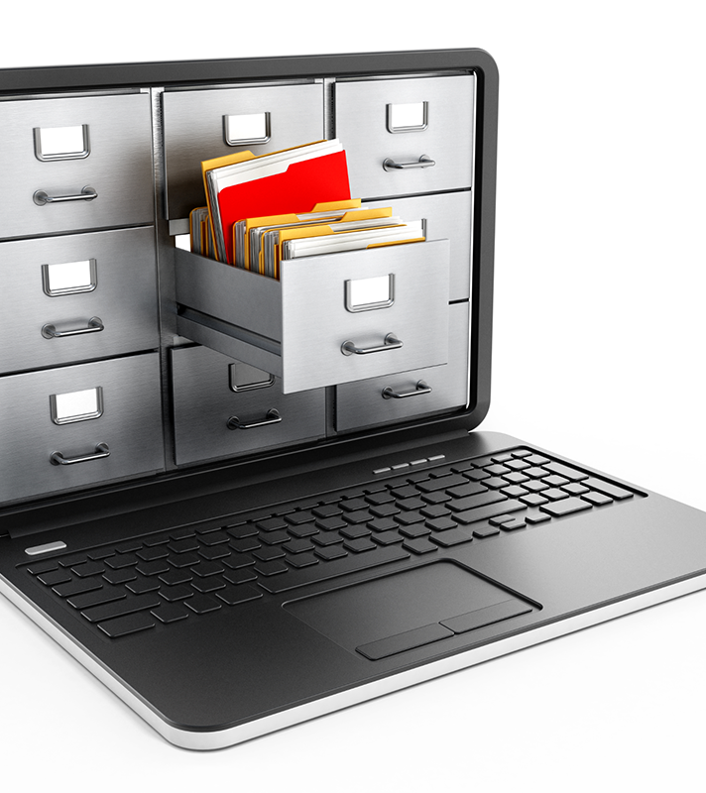
Finalization and Distribution of Minutes
This Photo by Unknown Author is licensed under CC BY-SA-NC
Notes:
Reviewing with Committee Chair and confirming accuracy, Distributing minutes and ensuring accessibility

Slide 16

Reviewing with Committee Chair and confirming accuracy
Committee Chair Review
  Forward your notes to the committee chair for review to ensure alignment and clarity.
Confirming Accuracy
  Verify the correctness of decisions and assignments to maintain accountability and transparency.
Notes:
---
Review with the Committee Chair (if required)
Confirm accuracy of decisions and assignments.
Image source: Microsoft 365 content library

Slide 17

Distributing minutes and ensuring accessibility
Timely Distribution
  Send meeting minutes to all attendees within 24 hours to ensure prompt communication.
Organized Filing
  File minutes in a designated shared location for easy access and future reference.
Ensuring Accessibility
  Make sure minutes are accessible to all relevant stakeholders for future meetings.
Notes:
---
Distribute to attendees within 24 hours
Use the shared EA mailbox for consistency.
File the minutes in the designated shared location
Ensure they’re accessible for reference in future meetings.
Image source: Microsoft 365 content library

Slide 18

Follow-Up Actions and Preparation for Next Meeting
Notes:
Tracking action items and entering tasks into tracking systems, Preparing for the next meeting using previous minutes, Example Copilot prompt for open action items

Slide 19
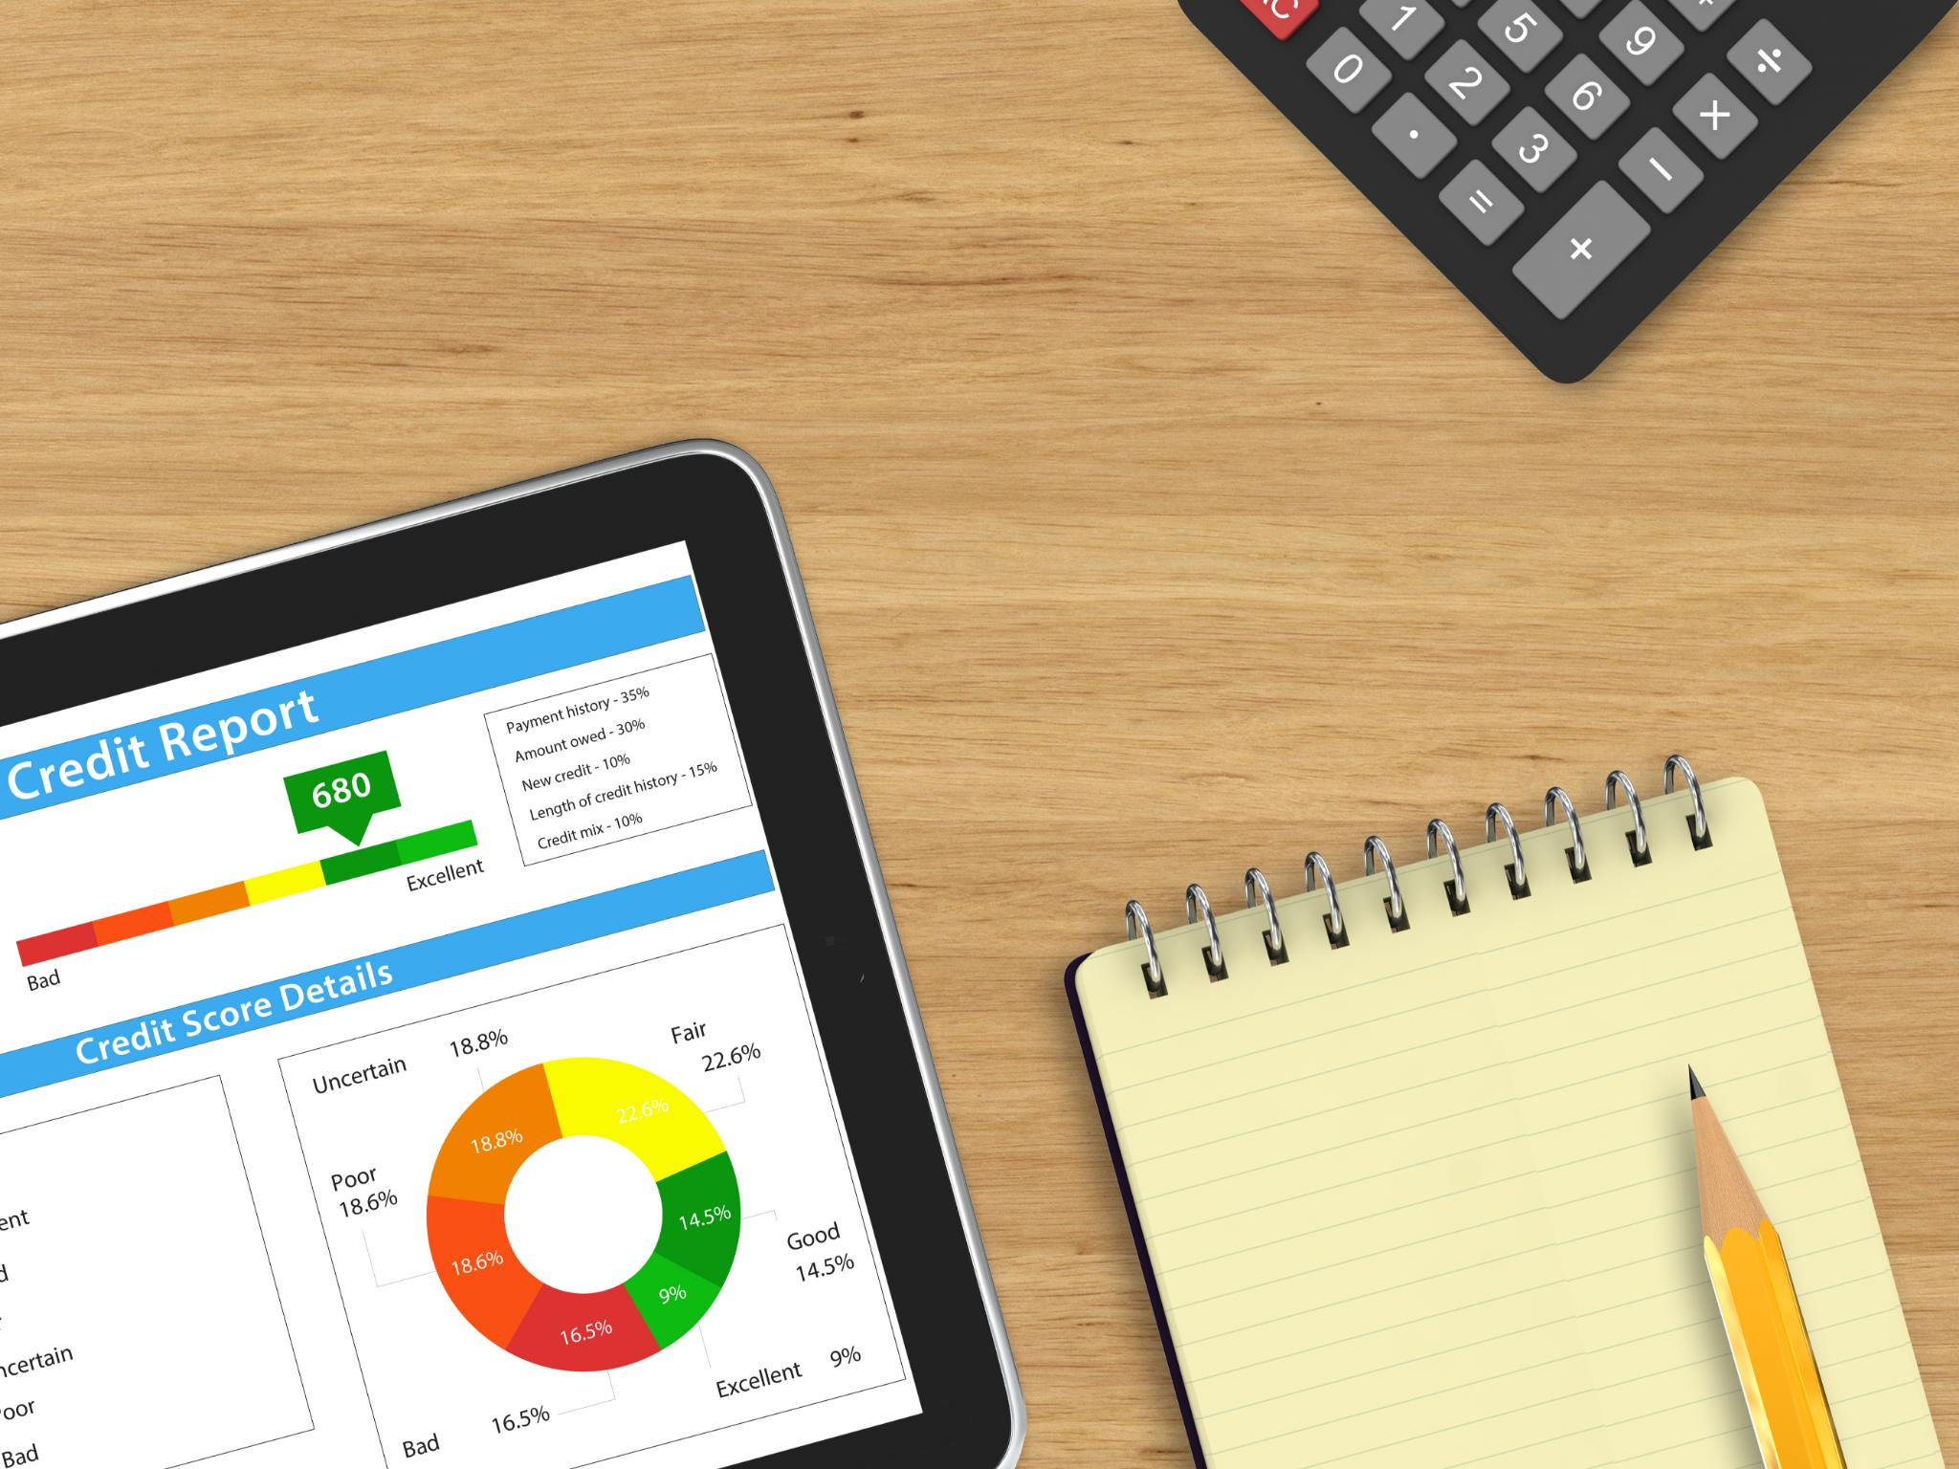
Tracking action items and entering tasks into tracking systems (if used by committee)
Track Action Items
  Keep a clear record of all action items to ensure accountability and progress.
Enter Tasks into Planner
  Input tasks promptly into Teams Planner or designated system for organized workflow management.
Notes:
---
Track action items
Enter tasks into Teams Planner (or designated tracking system).
Image source: Microsoft 365 content library

Slide 20
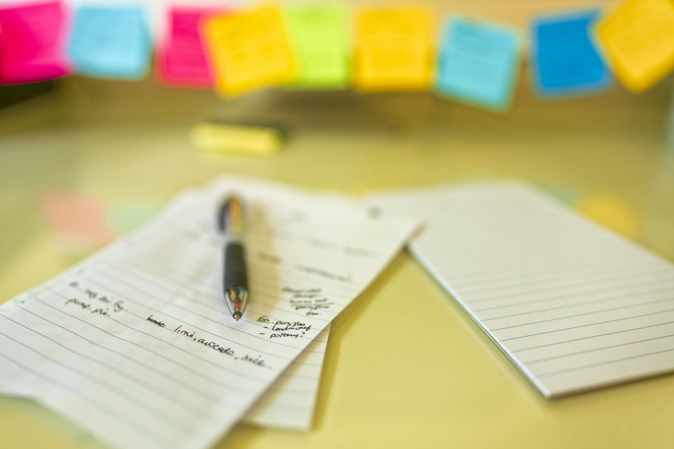
Preparing for the next meeting using previous minutes
Review Previous Minutes
  Carefully examine previous meeting minutes to gather important updates and decisions made.
Update the Chair
  Inform the Chair about key points from previous meetings to keep them well-prepared.
Inform the Agenda
  Use insights from previous minutes to shape and organize the agenda for the upcoming meeting.
Notes:
---
Prepare for the next meeting
Use previous minutes to update the Chair and inform the agenda.
Image source: Microsoft 365 content library

Slide 21

Tips for Consistency in Minute-Taking
Notes:
Importance of using a consistent template

Slide 22

Importance of using a consistent template
Enhances Recognition
  Using a consistent template helps committee members quickly recognize key information across documents.
Improves Efficiency
  A uniform template allows faster navigation to decisions and assignments during meetings.
Notes:
---
📌 Tip for consistency: Always use the same template so committee members know where to quickly find decisions and assignments.
Image source: Microsoft 365 content library

Slide 23
Conclusion
Thorough Preparation
  Preparing thoroughly before meetings enables accurate and comprehensive minute-taking.
Prompt Follow-up
  Promptly following up on action items maintains accountability and momentum after meetings.
Use of Digital Tools
  Leveraging digital tools like Copilot streamlines minute-taking and increases efficiency.
Notes:
Effective minute-taking in management-level committee meetings requires thorough preparation, active documentation, prompt follow-up, and consistency. Using tools like Copilot can streamline this process and improve accuracy. Following these steps ensures clear records that support decision-making and accountability.

Slide 24
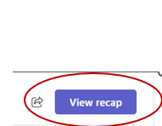
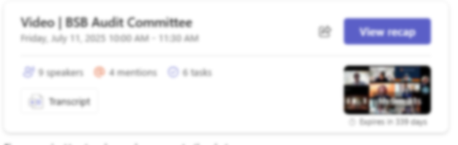
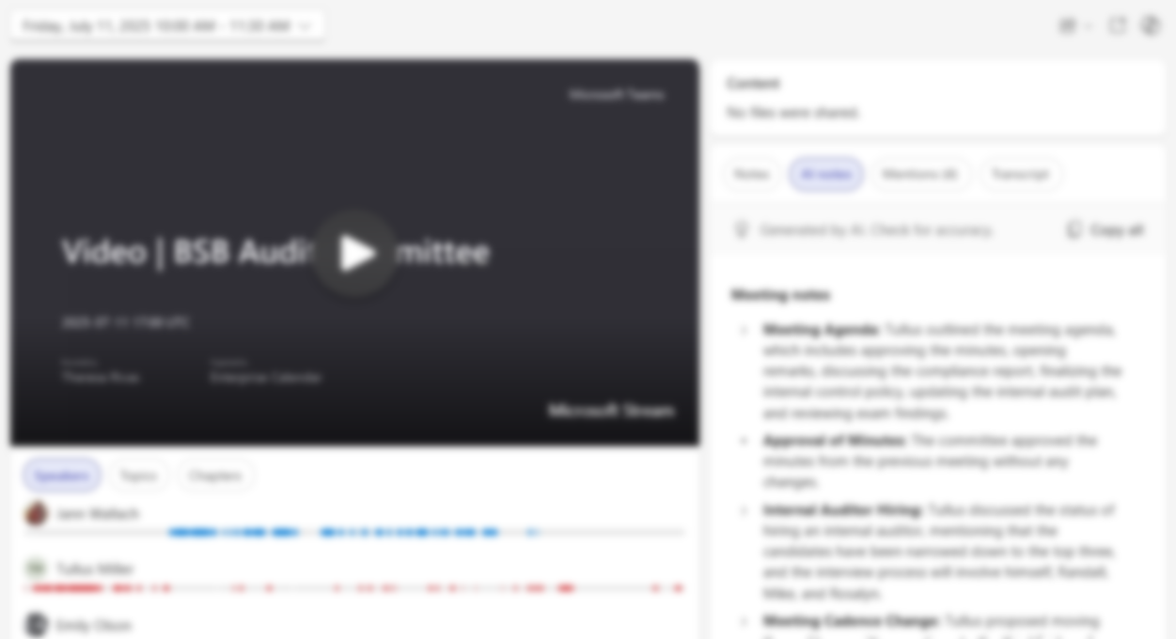
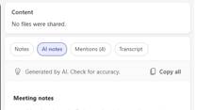
Using AI Generated Notes
Meeting Notes & Follow-up tasks
  Access notes in Meeting Chat under View recap
  Review key discussion points & decisions made and align to the agenda topics on your minutes template
  Best Practice
  Always review AI generated content for accuracy
Notes:
Effective minute-taking in management-level committee meetings requires thorough preparation, active documentation, prompt follow-up, and consistency. Using tools like Copilot can streamline this process and improve accuracy. Following these steps ensures clear records that support decision-making and accountability.

