Slide 1

Executive Administrative Support Team
Streamlining administrative support through centralization.
Theresa Rivas
Notes:
Title Page

Slide 2
Executive Administrative Support Team Proposal
This business case proposes the creation of an Administrative Support Team to replace the current single executive assistant model. This change aims to enhance efficiency, provide broader skill sets, improve service levels, mitigate risks, support strategic initiatives, and promote employee well-being. The transition to a team-based approach will better align with our bank’s growth and operational needs, ensuring sustained support for our executives and leaders.
Notes:
Add model building is scalable.
Benefit of having an admin leader that gets the role of an EA more than the Executive

Slide 3
Executive Administrative Support – Purpose Statement
The Executive Administrative Support Team exists to support the CEO, Executive Leadership Team (ELT), and Board of Directors by efficiently managing priorities, streamlining communication, and ensuring a collaborative workflow, thereby allowing the organization’s leaders to focus on strategic initiatives that increase mission impact, enhance client experience, and ensure operational effectiveness and efficiencies.

Slide 4
What is the purpose of the Admin Team
1. Enhanced Efficiency and Productivity
Division of Labor: An administrative support team can allocate tasks according to each member's strengths and expertise, leading to higher productivity and more efficient task completion.
Reduced Bottlenecks: With multiple team members, we can avoid delays caused by over-reliance on a single assistant. Tasks will continue seamlessly even if one member is unavailable.
5. Broader Skill Set
Specialization: A team allows for specialization in key areas such as IT support, communications, project management, and financial analysis, enhancing the quality and effectiveness of support provided.
Cross-Training: Team members can be cross-trained to handle various responsibilities, creating a versatile and resilient support structure.
3. Improved Service Levels
Availability and Responsiveness: A team structure ensures continuous availability during business hours, allowing for prompt and effective handling of requests and tasks.
Scalability: As our bank grows, the administrative demands will also increase. A team-based approach is scalable, allowing us to add new members without overburdening existing staff.
4. Risk Mitigation
Continuity: The risk associated with the absence or turnover of a single assistant is mitigated by having multiple team members knowledgeable about critical tasks.
Redundancy: With redundancy built into the team, we can maintain operational stability even in the face of unexpected challenges.
2. Enhanced Strategic Support
Project Management: A team can manage complex projects more effectively, ensuring alignment with our strategic goals and enhancing project outcomes.
Comprehensive Coverage: Administrative support will extend beyond the executive level to all departments, fostering integrated and cohesive support across the organization.
6. Employee Well-being and Morale
Workload Management: Distributing tasks among a team helps prevent burnout and maintain a healthy work-life balance for all members.
Career Development: A team environment offers opportunities for professional growth, skill development, and career advancement, contributing to higher job satisfaction and retention.

Slide 5
Milestones and Expectations for Admin Team Implementation Plan
1. Assessment and Planning
Milestone: Conduct a thorough assessment of current administrative support needs and workflows.
Expectations:
Identify and document the current tasks, responsibilities, and workloads of individual admin support.
Survey senior leadership to understand their specific needs and preferences.
Develop a comprehensive plan outlining the transition to an admin team.
2. Stakeholder Engagement
Milestone: Engage with stakeholders (senior leadership and current administrative staff) to gather input and build support for the change.
Expectations:
Hold meetings with senior leadership to present the benefits of an admin team and address concerns.
Conduct focus groups or one on one meetings with current admin staff to discuss the upcoming changes and gather feedback.
Create a communication plan to keep all stakeholders informed throughout the transition process.
3. Design and Structure
Milestone: Design the structure and processes for the admin team.
Expectations:
Define roles and responsibilities within the admin team.
Develop standardized procedures and protocols for task assignment, prioritization, and completion.
Establish a system for tracking and managing admin support requests from senior leadership.
4. Training and Development
Milestone: Provide training for the admin team to ensure they are equipped to handle the new structure.
Expectations:
Conduct training sessions on the new processes, tools, and best practices for admin support.
Offer professional development opportunities to enhance skills relevant to the new team structure.
Ensure ongoing support and resources are available to address any training gaps.
Notes:
These milestones and expectations are based on recent discussions on how to better align administrative support with the needs of our executive team and organization. By defining roles and responsibilities within the administrative support team, transitioning to a team-based approach, and assessing current staff and administrative tasks, we can provide more efficient and effective support for our executives and leaders. The recruitment process will help us bring in individuals with specialized skills and expertise, while the comprehensive training program will ensure all team members are well-prepared to handle their duties. Regular evaluation of team performance will help us fine-tune our approach and optimize efficiency and effectiveness.

Slide 6
Milestones and Expectations for Admin Team Implementation Plan
5. Plan Implementation
Milestone: Launch the admin team program across executive leadership.
Expectations:
Transition all senior leaders to the new admin support structure.
6. Evaluation and Adjustment
Milestone: Evaluate the pilot program and make necessary adjustments.
Expectations:
Analyze feedback from senior leadership and the admin team regarding the pilot.
Assess key performance indicators (KPIs) such as response time, task completion rates, and satisfaction levels.
Implement improvements based on the evaluation to optimize the admin team model.
7. Continuous Improvement
Milestone: Establish a continuous improvement process for the admin team.
Expectations:
Regularly review and refine processes and procedures based on feedback and performance data.
Foster a culture of continuous improvement and adaptability within the admin team.
Hold regular check ins with senior leadership to ensure their needs are being met and to gather feedback.
Ensure all admin team members are fully integrated and understand their roles.
Provide ongoing support and resources to ensure a smooth transition.
Notes:
These milestones and expectations are based on recent discussions on how to better align administrative support with the needs of our executive team and organization. By defining roles and responsibilities within the administrative support team, transitioning to a team-based approach, and assessing current staff and administrative tasks, we can provide more efficient and effective support for our executives and leaders. The recruitment process will help us bring in individuals with specialized skills and expertise, while the comprehensive training program will ensure all team members are well-prepared to handle their duties. Regular evaluation of team performance will help us fine-tune our approach and optimize efficiency and effectiveness.

Slide 7
Administrative Support - Attributes
Executive Support
Project Coordination
Problem Solver/Solution Oriented
Events Specialist
Org Efficiency & Design
Efficient with Technology
Innovative with Technology
Learning Agility
Resource Management
Travel Hub – Concur
Facilities/Office Management
Central - Office Supply Management
Mail Management
Vendor/Consultant Management
Expense Management
Relational
Strategic Relationship Development
Team Building
Communication
Political Savvy
Service Leadership
Behavioral
Ambitious
Influence
Emotional Intelligence
Conflict Resolution
Confidentiality and Trust
Courteous Behavior & Confident Presence
Growth Mindset
Adaptability
Proactive
Notes:
What do you mean by attribute? a quality, character, or characteristic ascribed to someone or something. has leadership attributes.

Slide 8
Admin Competencies
Calendar Management:
Conducting market research and competitive analysis.
Compiling data and creating reports or presentations.
Providing insights and recommendations based on findings.
Document Preparation:
Formatting documents, reports, and presentations.
Proofreading and editing content for clarity and consistency.
Ensuring branding and style guidelines are followed.
Project Coordination:
Assisting in project planning and tracking milestones.
Coordinating tasks and deadlines among team members.
Providing status updates and facilitating communication.
Scheduling appointments, meetings, and events.
Coordinating availability among team members.
Sending reminders and managing conflicts.
Travel Arrangements:
Booking flights, accommodations, and ground transportation.
Organizing itineraries and necessary travel documents.
Managing changes and cancellations efficiently.
Email and Correspondence Management:
Monitoring and prioritizing incoming emails.
Drafting responses and managing follow-ups.
Filtering spam and irrelevant messages.
Meeting Support:
Preparing agendas and materials for meetings.
Taking minutes and distributing action items.
Ensuring virtual and in person meeting rooms are properly set up and equipped.
Research and Analysis:
Board Governance:
Planning meetings, generating reports, meeting materials and minutes.
Communicating with board members regarding related activities.
Working closely with board members and committees to achieve goals.
Notes:
What do you mean by competencies? Competencies are the knowledge, skills, abilities, and behaviors that contribute to individual and organizational performance. Knowledge is information developed or learned through experience, study or investigation. Skill is the result of repeatedly applying knowledge or ability.

Slide 9
Admin Competencies
Event Planning and Coordination:
Maintaining confidentiality of sensitive information.
Establishing and enforcing data security protocols.
Handling sensitive documents and information with discretion.
Communication Liaison:
Serving as a point of contact between the executive and other team members, departments, clients, and external partners.
Facilitating effective communication and information flow.
Technology Assistance:
Providing technical support for software, tools, and devices used by the executive.
Troubleshooting issues.
Keeping abreast of new technologies to enhance efficiency.
Budget Planning:
Collaborate with the executive to develop budgets for various projects, departments, or initiatives.
Research and gather data to inform budgeting decisions.
Create budget proposals and presentations for review and approval.
Expense Tracking:
Monitor and track expenses against budget allocations.
Record and categorize expenses accurately in financial systems or spreadsheets.
Identify discrepancies or irregularities and address them promptly.
Expense Reporting:
Prepare detailed expense reports for the executive's review.
Ensure compliance with company policies and expense guidelines.
Submit expense reports in a timely manner and follow up on approvals.
Organizing company events, conferences, and team-building activities.
Securing venues, catering, and necessary equipment.
Managing invitations, RSVPs, and logistics.
Confidentiality and Data Management:
AI Adoption:
Assist with AI tools adoption, becoming an early adopter and subject matter expert
Train staff on AI usage
Integrate AI tools in department workflows
Identify AI opportunities and implement AI solutions

Slide 10
Executive Administrative Support Roles
Executive Assistant III
Executive Office
Sr. Leaders
Executive Assistant II
Sr. Leaders
Business Lines
Executive Assistant I
Business Lines
Office
Chief Executive Assistant
CEO
Board of Directors
Executive Office
Business Lines

Slide 11
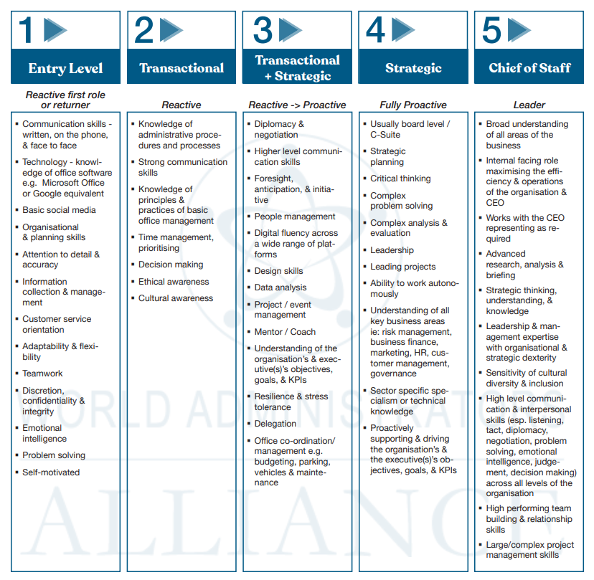
Skills Matrix

Slide 12
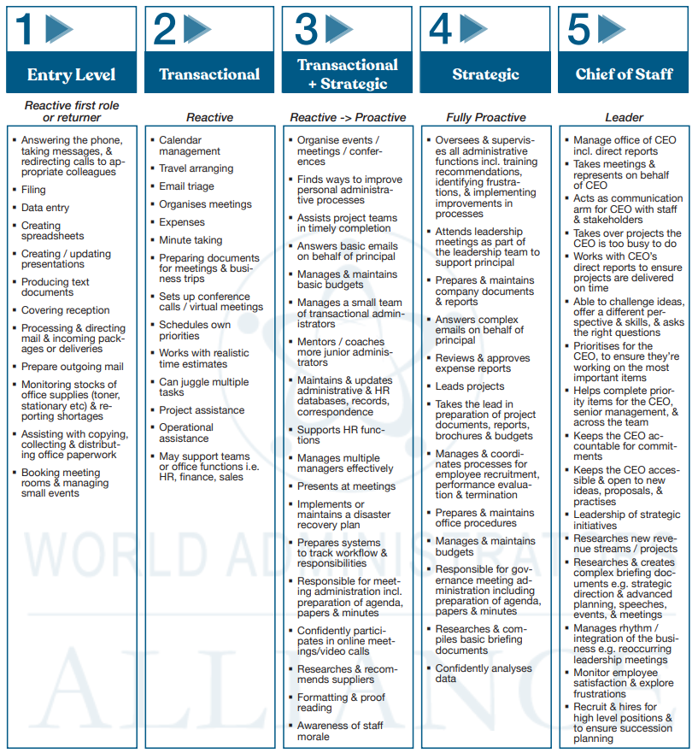
Task Matrix
Admin Assistant
Executive Assistant I
Executive Assistant II
Executive Assistant III
Chief Executive Assistant

Slide 13
Timeline
Milestones: | Expectations: | June | July | Aug | Sept | Oct | Nov | Dec | Jan | Feb
Assessment & Planning | Identify current responsibilities
 | Survey Sr. Leaders for needs
 | Outline plan for transition
Stakeholder Engagement | Present benefits of admin team to Sr. Leaders
 | Meet with current admins to discuss changes
 | Create communication plan about transition
Design & Structure | Define roles and responsibilities
 | Develop standards of performance
 | Establish a system for tracking requests
Training & Development | Conduct training on tools and best practices
 | Provide professional development to build skills
 | Provide ongoing training to address gaps
Implementation | Transition to new support structure
 | Ensure team is integrated & monitor performance
 | Check in with Sr. Leaders to gather feedback
Evaluation & Adjustment | Analyze feedback from Sr. Leaders
 | Assess KPIs: response time, completion, satisfaction
 | Implement improvements based on feedback
Continuous Improvement | Regularly review and refine processes
 | Foster a culture of continuous improvement
 | Hold regular check ins with Sr. Leaders

Slide 14
How to support Theresa in the new role:
Nova Chief of Staff certification course
Assign business coach (external) or executive coach/mentor (internal)
Continued support from Human Capital
Clear expectations of the role
  Job description
  Goals and Objectives
    90 days, 6 months, 1 year, and beyond
    How to measure success
  Salary commensurate to the new role and responsibilities
Notes:
Who to go to
Goal to get feedback from leaders about the support they are getting
Have the conversation of feedback where gap are.

Slide 15
Communication Plan
Pre-Presentation:
Define Objectives: Clearly outline the goals of the presentation to align the team's efforts.
Identify Audience: Determine who will be attending and tailor the communication accordingly.
Develop Key Messages: Highlight the main points you want to convey in the presentation.
During Presentation:
Engage the Audience: Use interactive elements to keep the audience involved.
Deliver Key Messages: Ensure the main points are communicated effectively.
Visual Aids: Utilize slides, charts, and graphs to support your message.
Post-Presentation:
Feedback Collection: Provide a way for attendees to give feedback on the presentation.
Follow-Up Communication: Send a summary of the presentation and next steps to all participants.
Action Items: Outline clear action items and responsibilities moving forward.
Please let me know if you need any specific details or if there's anything else I can assist you with!

Slide 16
Executive Summary
Why do we need an admin team?
Current resources are limited and misaligned with only two Admins supporting the whole organization
Present structure is siloed and not sufficiently aligned with the needs of our executive team and organization
What are we solving for?
Unclear job role and responsibility, goals and expectations
Alignment & accountability of resources
Siloed workflows
Undefined skill set
Under supported events
Inconsistent processes, procedures, and service levels
What are the benefits?
Org Efficiency, Productivity, Clarity, and Collaboration
Improved Service and Strategic Support
Continuity, Scalability, and Responsiveness
Increased level of skill set and consistent service levels
Learning and Development & Assistant Career Path opportunity
Administrative coaching partnership for leaders (leading up)
Advocate for Admin Staff
Hiring and onboarding EAs
We are centralizing many of the support functions across the organization

Slide 17
What are we doing?
We are creating a Centralized Administrative Support Team
The Admin Team will report to a Team Lead
The Team will support Senior Leaders and Managers of the Bank
We will create a system to track to-dos and accomplishments
Notes:
Not a pool –
Planner board with To Dos

Slide 18
Why are we doing it?
Centralized Administrative Support can offer several benefits, including:
Enhanced Efficiency: By working as a team, administrative assistants can share information, resources, and materials quickly and effectively, leading to expedited and cost-effective operations.
Talent Management: It allows for better utilization of each admin's skill set, ensuring high-quality support and a unified approach to achieving departmental and company goals.
Strategic Growth: The administrative team should focus on continuous learning and skill enhancement including staying updated on the latest technology and automating routine tasks and adopting best practices for workflow management.
Notes:
Talent management – excel spreadsheet self ranking – better partner the admin to the request
Software tools: Microsoft: Excel, Word
Soft sills
Event planning
Project management
Written

Slide 19
Implementation Plan:
Team Structure: Define the roles and responsibilities within the administrative support team, ensuring coverage for all critical areas.
Integration: Transition from the single assistant model to the team-based approach, ensuring minimal disruption to ongoing operations.
Communication: Develop a clear communication plan to ensure executives and the organization are aligned and informed.
Assessment: Assess current staff and administrative tasks and identify specific areas where team support can enhance efficiency through process improvement or technology deployment. Assess the existing needs of the executive team to ensure optimal support.
Training: Implement a comprehensive training program to ensure all team members are well-prepared to handle their duties. Implement a system and train executives how to request service.
Evaluation: Regularly evaluate the performance of the administrative support team and adjusting as needed to optimize efficiency and effectiveness.
Recruitment: Initiate the recruitment process to bring in individuals with the required skills and expertise as needed.

Slide 20
Executive Administrative Support Plan - Proposed
Chief Executive Assistant
Supports CEO & Board
Manages Admin Team
Executive Assistant
Supports Executive Leadership
Repots to CEA
Executive Assistant
Supports Sr. Leadership
Reports to CEA
Admin Assistant
Supports as needed
Reports to CEA

